Slide 1
The Impact of the Global Economy
Vicky Pryce
Chief Economic Adviser
CEBR
December 2019

Slide 2
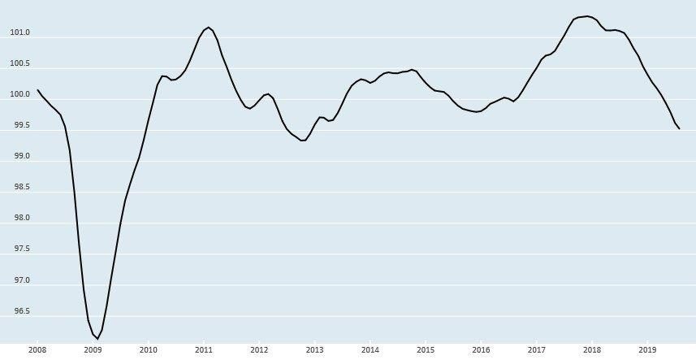
OECD- Business Confidence Index-continues to decline

Slide 3
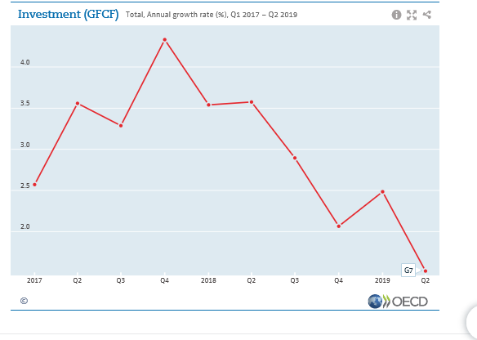

Slide 4
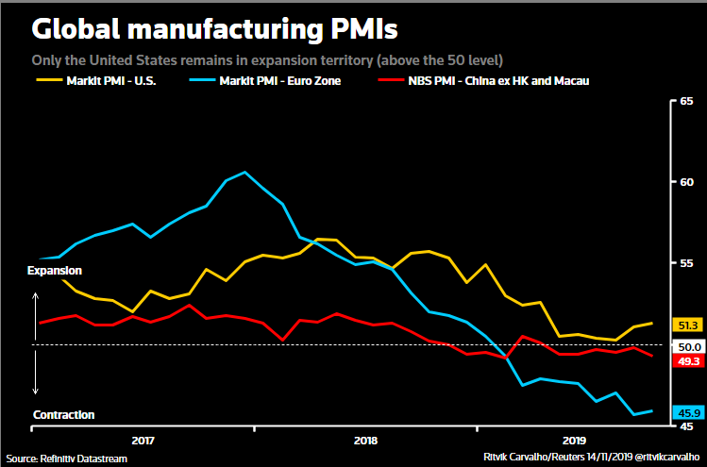

Slide 5
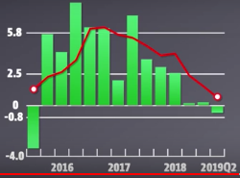
..now slowing down: Trade volumes- red line year on year, green bars quarterly change % Source: OECD

Slide 6
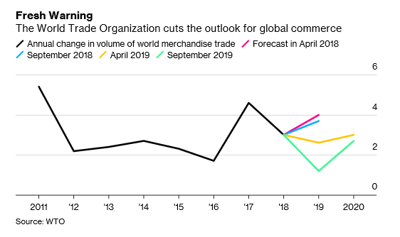
Latest WTO trade outlook gloomier still

Slide 7
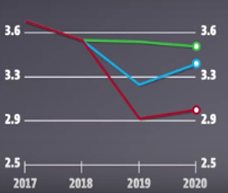
OECD latest forecast for world growth – November 2018, May 2019, September 2019

Slide 8
Risks ahead
Trade protectionism more harmful than past as world trade rising as share of GDP
US/China etc trade wars have dampening effect on growth
Number of emerging economies exposed to high public sector and for some alsolarge foreign currency debt- China, Greece, Venezuela, Argentina,Turkey, Mexico, Russia, Brazil, India, etc
High private sector debt creates vulnerabilities- e.g. in China, 160% of GDP
Deep financial integration means contagion and domino effect ever present
China’s increasing trade ambitions
Brexit and worries about trade deals ahead

Slide 9
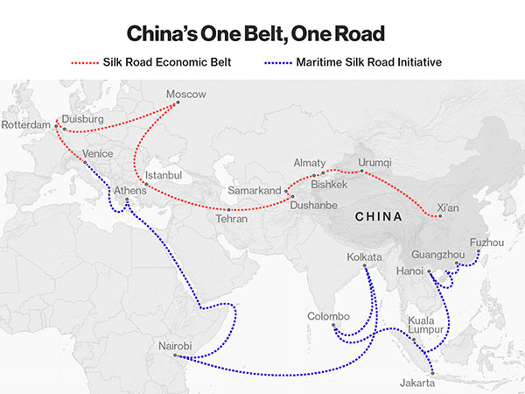

Slide 10
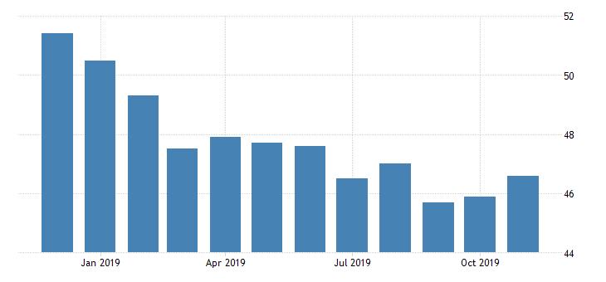
IHS Markit Eurozone Manufacturing PMI

Slide 11
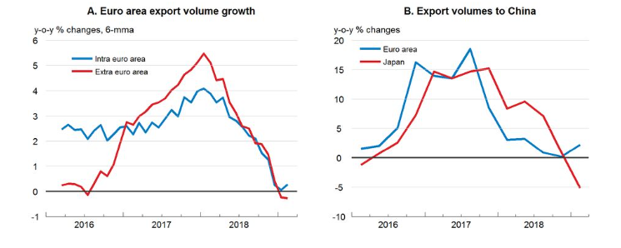
In Eurozone trade slowdown main contributor as well as end of monetary stimulus- now resuming

Slide 12
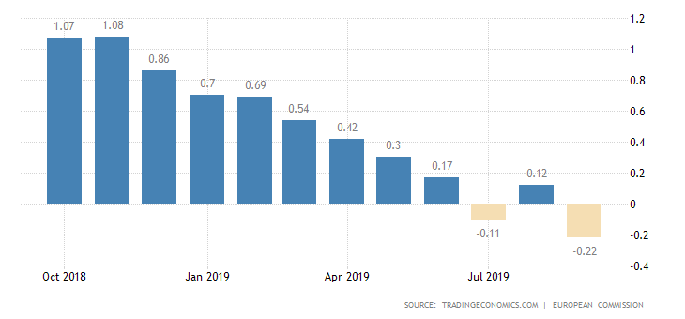
Euro Area Business Climate Indicator fell again recently

Slide 13
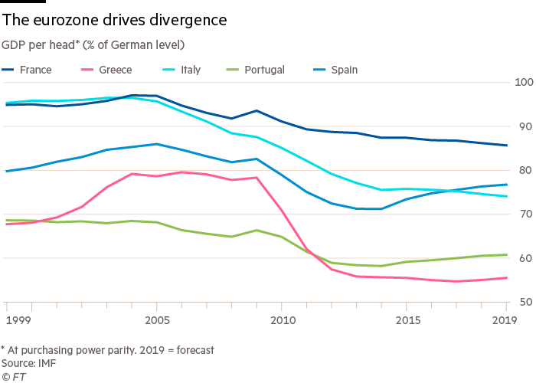

Slide 14
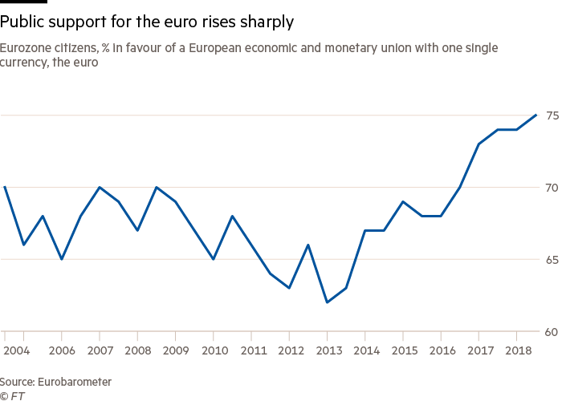
In meantime , surprisingly :

Slide 15
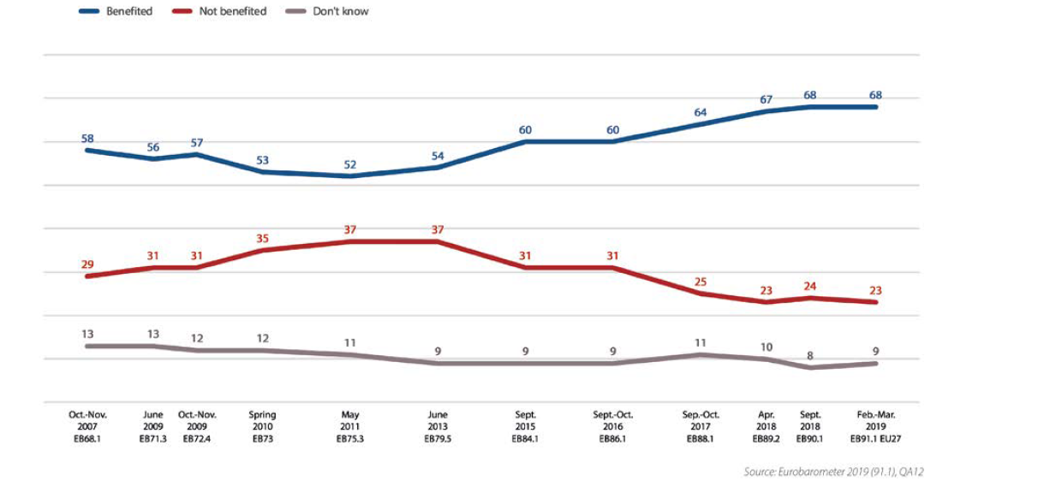
Has your country benefited from being a member of the EU/ (% EU)

Slide 16
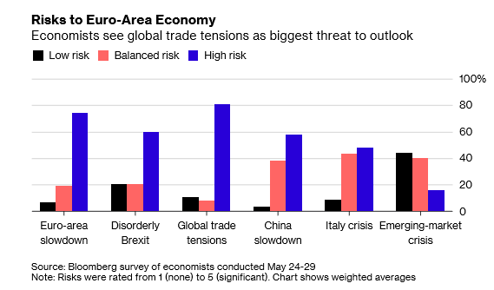

Slide 17
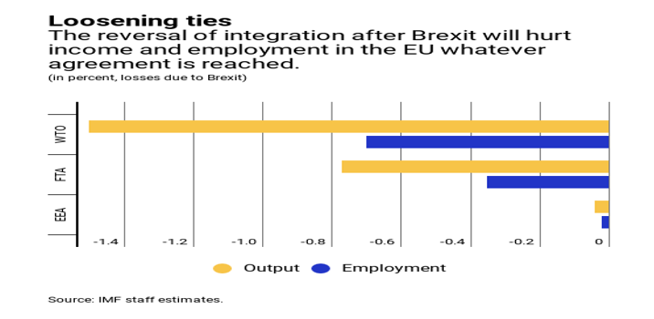

Slide 18
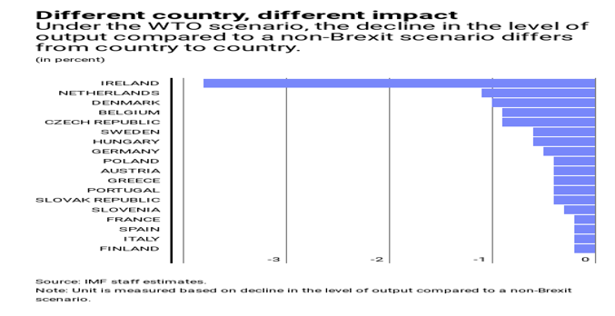

Slide 19
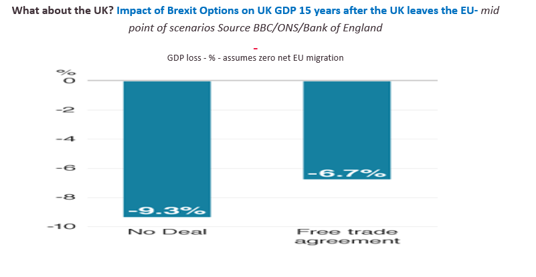

Slide 20
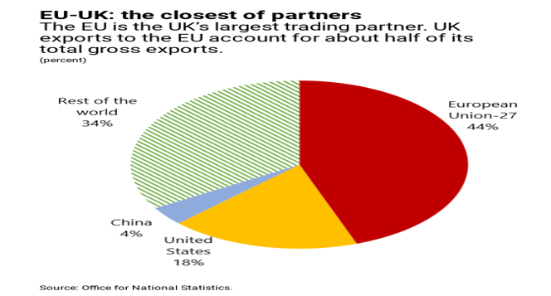

Slide 21
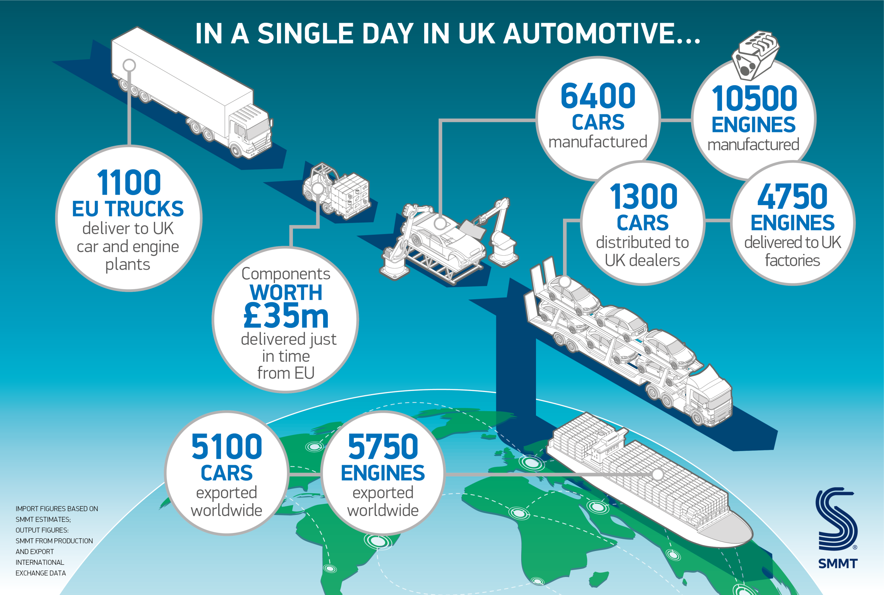

Slide 22
Why worry: source: London First-June 2016- threat over passporting, Euro Clearing, EAB etc

Slide 23
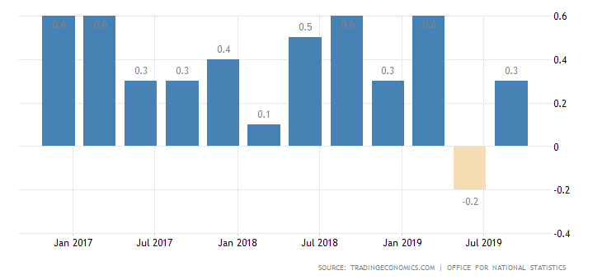
UK Economy already in trouble: has grown some 3% slower since referendum than otherwise and contracted in Q2 with productivity falling or stagnatn years : United Kingdom GDP Growth Rate-% q-on-q

Slide 24
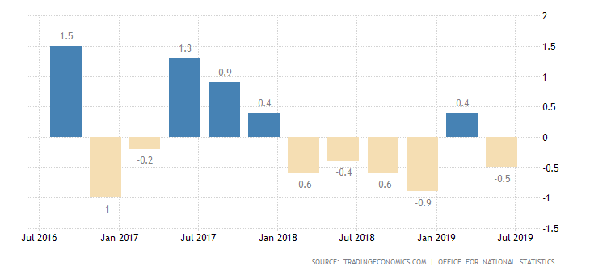
United Kingdom Business Investment- % change

Slide 25
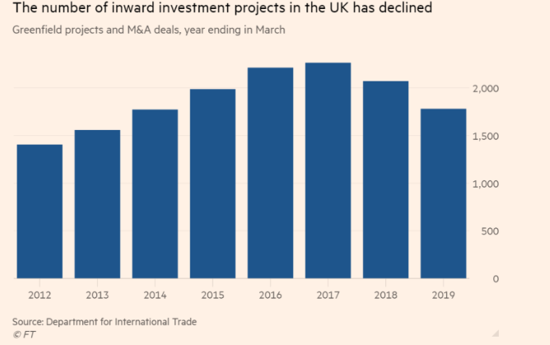
But in meantime economy suffering: Foreign greenfield investment volumes down 30% in three years to June, new employment created down by 19%
-

Slide 26
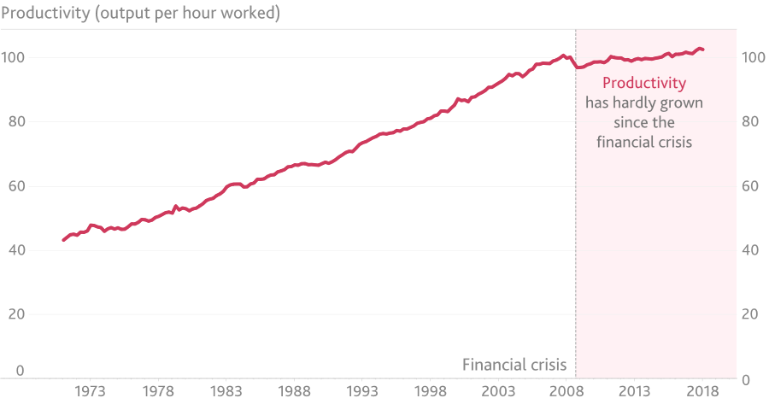

Slide 27
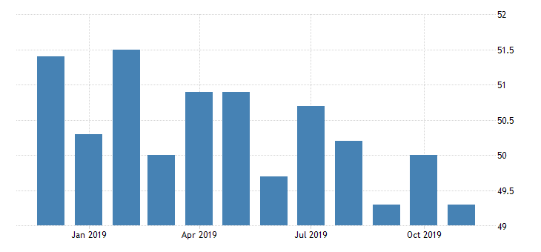
Indicators of output growth: United Kingdom Composite PMI- joint lowest since July 2016(referendum)falls in manufacturing, service and separately construction- below 50 indicates decline

Slide 28
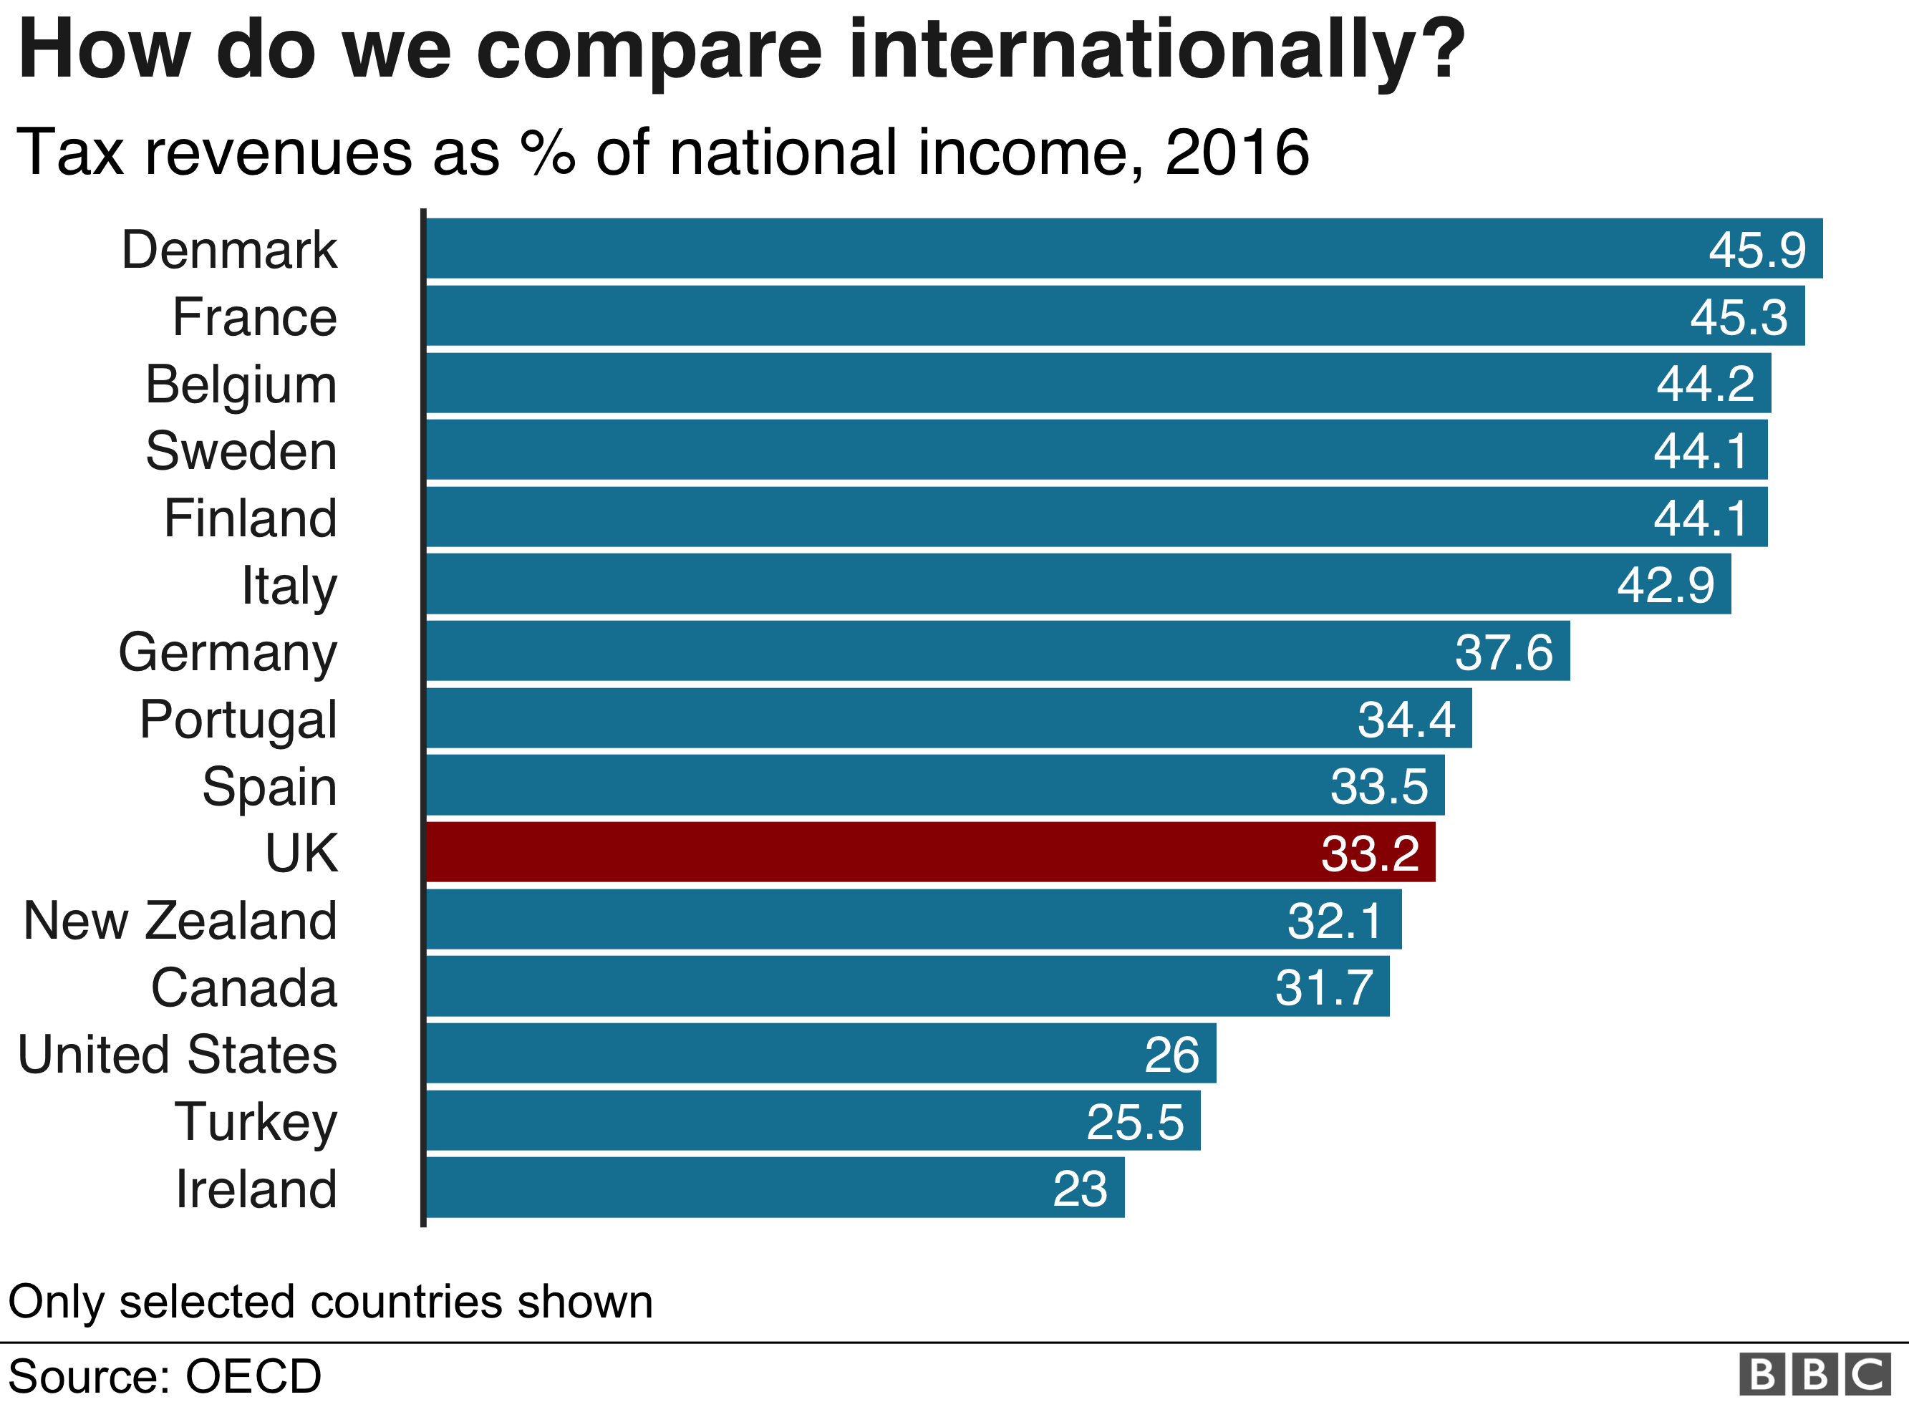
Meanwhile debate on what sort of country we want to be has intensified during election campaign

Slide 29
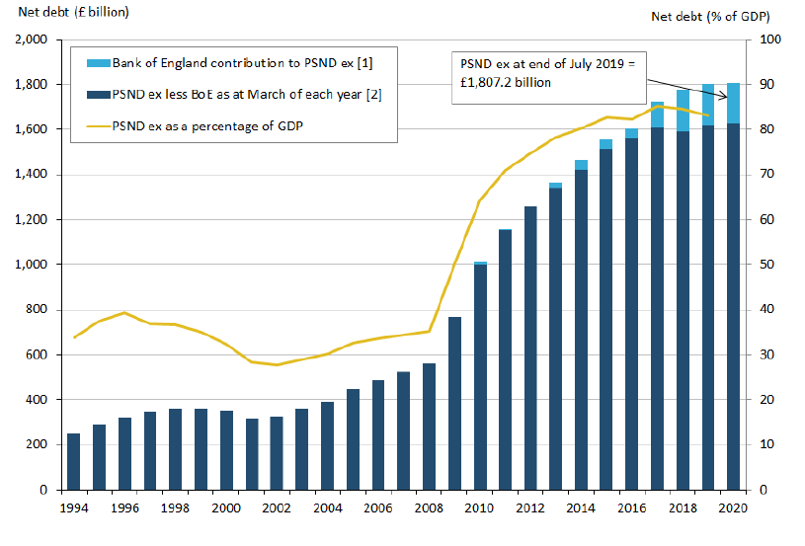
Funding needs will rise under either government persist but borrowing costs remain low

