Slide 1
Trade unions are good economics
Geoff Tily
5 December 2019

Slide 2
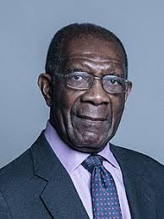
2019: Baron (Bill) Morris of Handsworth: General Secretary (GS) of the Transport and General Workers Union (TGWU) (1992 to 2003)
The late Henry Ford was visiting one of his factories in Detroit. His guest for the day was the late Walter Reuther, president of the United Automobile Workers. Henry Ford was describing how he had automated the factory and boasted that the robots would not be asking for a pay rise and that he could rely on their accuracy. Walter Reuther, the trade union leader, replied, “Yes, Henry, but they won’t be buying any of your damn cars either” (2019)

Slide 3
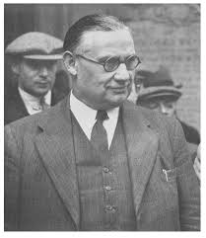
1919: Ernest Bevin, GS of TGWU (1922-1945), Minster of Labour and National Service (1940-45) & Foreign Secretary (1945-1951)
You have not realised that if you can raise the standard of life by 100 to 200 per cent that inevitably makes it better for all the producers concerned within your borders.

Slide 4
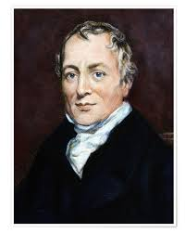
1817: David Ricardo (1772-1873)
[i]n the natural advance of society … the wages of labour will have a tendency to fall

Slide 5
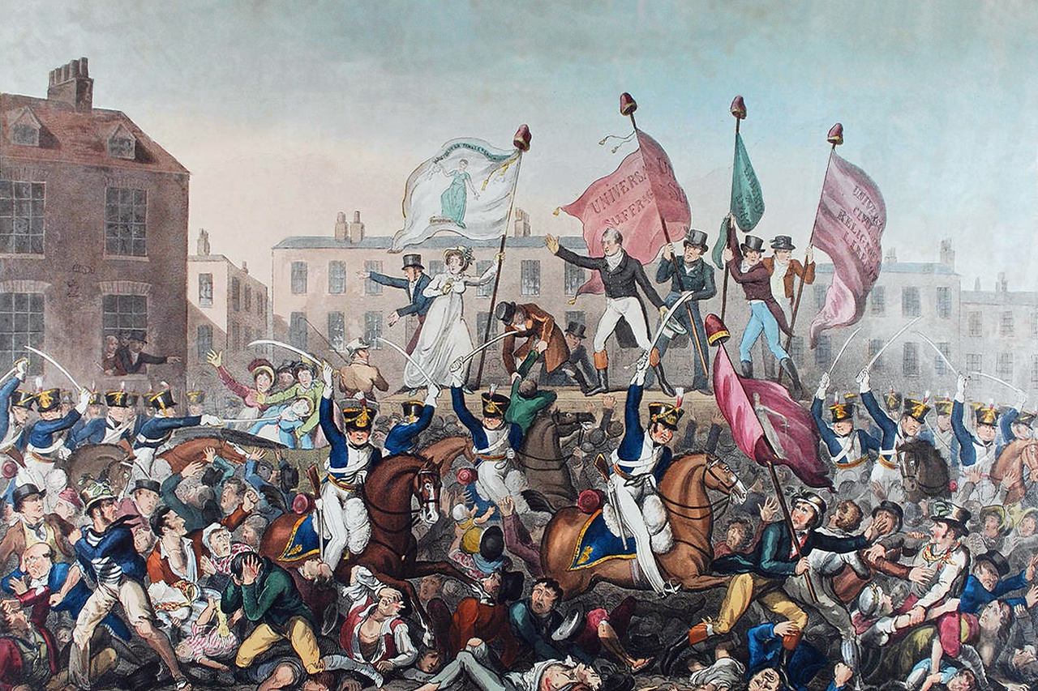

Slide 6
Union density

Slide 7
Labour market outcomes: 1860s to 2010s
bad
good
Too good?

Slide 8
Labour market outcomes: 1860s to 1890s

Slide 9
Labour market outcomes: 1890s to 1930s

Slide 10
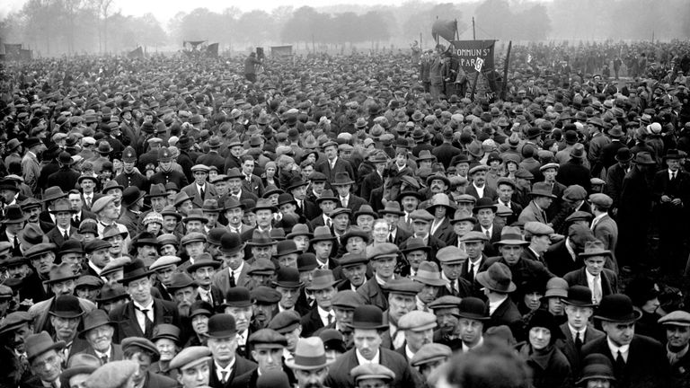

Slide 11
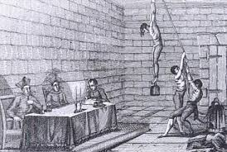
“Ricardo conquered England as completely as the Spanish inquisition conquered Spain”
Keynes’s General Theory (1936)

Slide 12
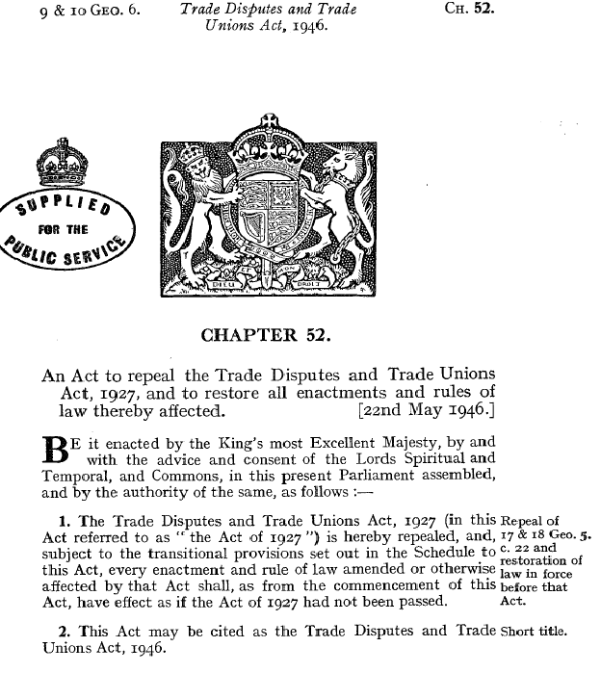

Slide 13
Labour market outcomes: 1930s to 1960s

Slide 14

Jobs Study, 1994
… many traditional patterns in the organisation of work and working-time remain enshrined in legislation or collective agreements. In this way, they hinder labour market flexibility and, indirectly, job creation. Less rigid arrangements for daily, weekly, annual and life-time working hours could meet both enterprise requirements and worker aspirations.

Slide 15
Labour market outcomes: 1960s to 2010s

Slide 16

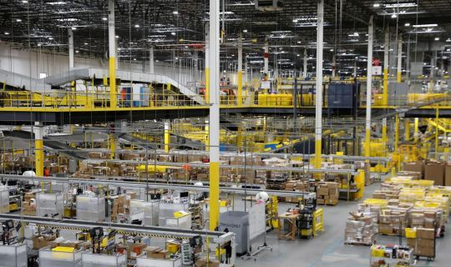
Using twenty-first century tech to deliver nineteenth-century exploitation.

Slide 17

OECD in 2019: Negotiating Our Way Up
“the weakening of social partners poses the common risk for all countries: that they find themselves without relevant and representative institutions to overcome collective action problems and strike a balance between the interests of workers and firms in the labour market”

Slide 18
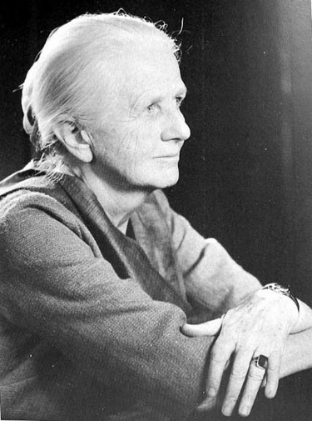
Joan Robinson (1903-1983)
“The purpose of studying economics is not to acquire a set of ready-made answers to economic questions, but to learn how to avoid being deceived by economists.”

Slide 19
Labour market outcomes: 1860s to 2010s

