Slide 1

UK Economy
Key UK macroeconomic variables in 2020
Ross Walker
Chief UK Economist & Co-Head of Global Economics NatWest Markets
ross.walker@natwestmarkets.com
9 December 2019

Slide 2
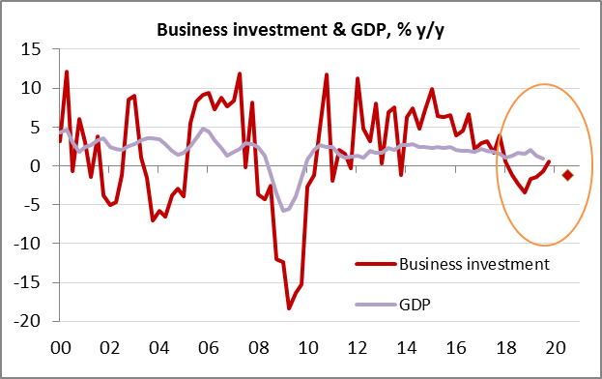
1. Business investment expenditure
  The most Brexit-sensitive GDP component. Early test of what Brexit could mean for the UK economy.
  Source: ONS
  https://www.ons.gov.uk/economy/grossdomesticproductgdp/bulletins/businessinvestment/apriltojune2019revisedresults

Slide 3
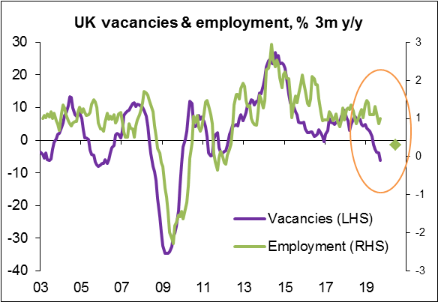
2. Job vacancies
  Vacancies have turned down. A good leading-indicator for employment and consumer demand
  Source: ONS
  https://www.ons.gov.uk/employmentandlabourmarket/peopleinwork/employmentandemployeetypes/bulletins/uklabourmarket/november2019

Slide 4
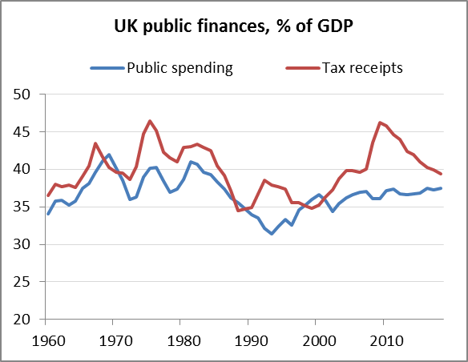
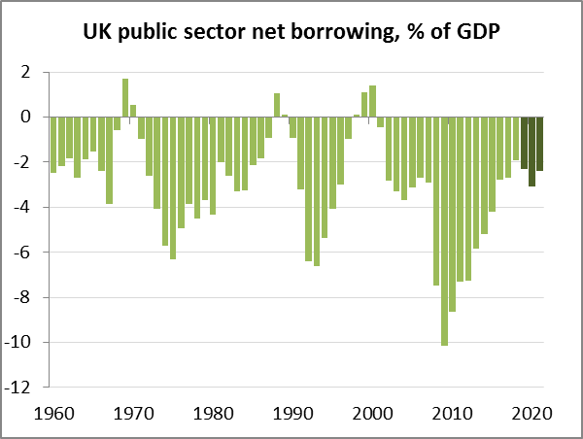
3. Fiscal expansion: more public spending & some tax cuts
  Single biggest policy change in 2020. Fundamental philosophical shift or short-term politics?
  Source: OBR
  www.obr.uk

Slide 5
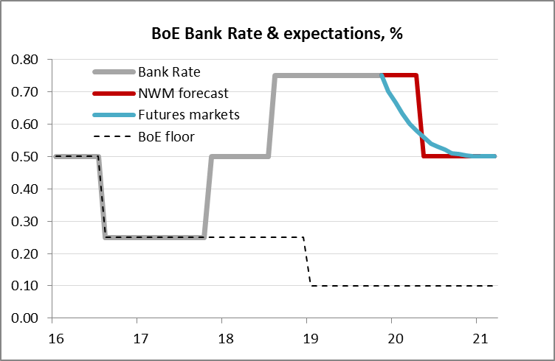
4. Bank of England Bank Rate
  Not much more room to cut interest rates, but MPC drifting in a ‘dovish’ direction. Negative rates?
  Source: BoE, Bloomberg
  https://www.bankofengland.co.uk/monetary-policy-report/2019/november-2019

Slide 6
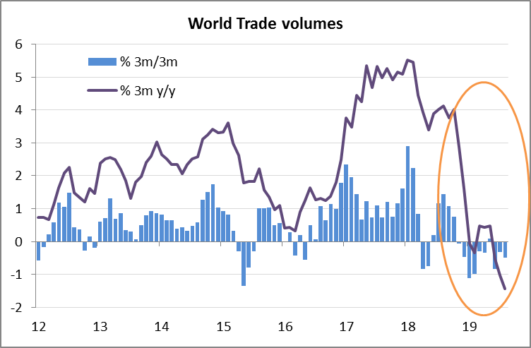
5. World trade
  Protectionism is on the rise . . . World trade has turned down sharply. . . US election year heightens risks
  Source: CPB World Trade Monitor
  https://www.cpb.nl/en/worldtrademonitor

Slide 7
Disclaimer
All data is accurate as of the report date, unless otherwise specified.
This communication has been prepared by NatWest Markets Plc, and should be regarded as a Marketing Communication, for which the relevant competent authority is the UK Financial Conduct Authority.
Please follow the link for the following information https://www.natwestmarkets.com/natwest-markets/regulation/mar-disclosures.html:
MAR Disclaimer
Conflicts of Interest statement
Glossary of definitions
Historic Trade ideas log
This communication has been prepared by NatWest Markets Plc, NatWest Markets N.V. or an affiliated entity (“NatWest Markets”).
This material is a Marketing Communication and has not been prepared in accordance with the legal and regulatory requirements designed to promote the independence of investment research and may have been produced in conjunction with the NatWest Markets trading desks that trade as principal in the instruments mentioned herein. This commentary is therefore not independent from the proprietary interests of NatWest Markets, which may conflict with your interests. Opinions expressed may differ from the opinions expressed by other business units of NatWest Markets. The remuneration of the author(s) is not directly tied to any transactions performed, or trading fees received, by any entity of the RBS Group, for example, through the use of commission-based remuneration.
This material includes references to securities and related derivatives that the firm's trading desk may make a market or provide liquidity in, and in which it is likely as principal to have a long or short position at any time, including possibly a position that was accumulated on the basis of this analysis material prior to its dissemination. Trading desks may also have or take positions inconsistent with this material. This material may have been made available to other clients of NatWest Markets before it has been made available to you and is not subject to any prohibition on dealing ahead of its dissemination. This document has been prepared for information purposes only, does not constitute an analysis of all potentially material issues and is subject to change at any time without prior notice. NatWest Markets does not undertake to update you of such changes. It is indicative only and is not binding. Other than as indicated, this document has been prepared on the basis of publicly available information believed to be reliable but no representation, warranty, undertaking or assurance of any kind, express or implied, is made as to the adequacy, accuracy, completeness or reasonableness of this material, nor does NatWest Markets accept any obligation to any recipient to update, correct or determine the reasonableness of such material or assumptions contained herein. NatWest Markets and each of its respective affiliates accepts no liability whatsoever for any direct, indirect or consequential losses (in contract, tort or otherwise) arising from the use of this material or reliance on the information contained herein. However this shall not restrict, exclude or limit any duty or liability to any person under any applicable laws or regulations of any jurisdiction which may not lawfully be disclaimed. The opinions, commentaries, projections, forecasts, assumptions, estimates, derived valuations and target price(s) or other statements contained in this communication (the “Views”) are valid as at the indicated date and/or time and are subject to change at any time without prior notice. NatWest Markets does not undertake to update you of such changes. Views expressed herein are not intended to be, and should not be viewed as advice or as a personal recommendation. The Views may not be objective or independent of the interests of the authors or other NatWest Markets trading desks, who may be active participants in the markets, investments or strategies referred to in this material. NatWest Markets will not act and has not acted as your legal, tax, regulatory, accounting or investment adviser; nor does NatWest Markets owe any fiduciary duties to you in connection with this and/or any related transaction and no reliance may be placed on NatWest Markets for investment advice or recommendations of any sort. You should make your own independent evaluation of the relevance and adequacy of the information contained in this document and make such other investigations as you deem necessary, including obtaining independent financial advice, before participating in any transaction in respect of the securities referred to in this document. This document is not intended for distribution to, or use by any person or entity in any jurisdiction or country where such distribution or use would be contrary to local law or regulation. The information contained herein is proprietary to NatWest Markets and is being provided to selected recipients and may not be given (in whole or in part) or otherwise distributed to any other third party without the prior written consent of NatWest Markets.
NatWest Markets and its respective affiliates, connected companies, employees or clients may have an interest in financial instruments of the type described in this document and/or in related financial instruments giving rise to potential conflicts of interest which may impact the performance of such financial instruments. Such interests may include, but are not limited to, (a) dealing in, trading, holding or acting as market-maker or liquidity provider in such financial instruments and any reference obligations; (b) entering into hedging strategies on behalf of issuer clients and their affiliates, investor clients or for itself or its affiliates and connected companies; and (c) providing banking, credit and other financial services to any company or issuer of securities or financial instruments referred to herein. NatWest Markets and its affiliates, connected companies, employees or clients may at any time acquire, hold or dispose or long or short positions (including hedging and trading positions) which may impact the performance of a financial instrument.
In the U.S., this Marketing Communication is intended for distribution only to major institutional investors as defined in Rule 15a-6 of the U.S. Securities Exchange Act 1934 (excluding documents produced by our affiliates within the U.S. which are subject to the following disclaimer https://www.agilemarkets.com/api/ds/v1/disclaimer/publication/2756). Any U.S. recipient wanting further information or to effect any transaction related to this trade idea must contact NatWest Markets Securities Inc., 600 Washington Boulevard, Stamford, CT, USA. Telephone: +1 203 897 2700.
NatWest Markets Plc is authorised by the Prudential Regulation Authority and regulated by the Financial Conduct Authority and Prudential Regulation Authority and is provisionally registered as a swap dealer with the United States Commodity Futures Commission. NatWest Markets N.V. is incorporated with limited liability in the Netherlands, authorised and regulated by De Nederlandsche Bank the Autoriteit Financiële Markten. It has its seat at Amsterdam, the Netherlands, and is registered in the Commercial Register under number 33002587. Registered Office: Claude Debussylaan 94, Amsterdam, The Netherlands. Branch Reg No. in England BR001029. NatWest Markets Plc is, in certain jurisdictions, an authorised agent of NatWest Markets N.V. and NatWest Markets N.V. is, in certain jurisdictions, an authorised agent of NatWest Markets Plc. Securities business in the United States is conducted through NatWest Markets Securities Inc., a FINRA registered broker-dealer (http://www.finra.org), a SIPC member (www.sipc.org) and a wholly owned indirect subsidiary of NatWest Markets Plc. NatWest Markets Securities Inc. is authorised by NatWest Markets Plc to act as its agent for certain kinds of its activities.
NatWest Markets Plc, Singapore branch [UEN: S85FC3595J] is regulated and authorised by the Monetary Authority of Singapore
For further information relating to materials provided by NatWest Markets, please view our Agile Markets Terms and Conditions
Copyright © 2018 The Royal Bank of Scotland Group plc. All rights reserved.
Version 30.04.2018

